Slide 1






When Complex Event Recognition Meets Cloud-Native Architectures
Shizhe Liu¹, Haipeng Dai¹, Meng Li¹, Yuemeng Zhang¹, Shaoxu Song²,
Zhifeng Bao³, Hancheng Wang¹, Xiaofeng Gao⁴, Guihai Chen¹
Nanjing
University¹
Tsinghua
University²
The University
of Queensland³
Shanghai Jiao
Tong University⁴
Notes:
Hello, everyone. I am Shizhe Liu, a Ph.D. student from Nanjing University.

Slide 2
Basic concepts: complex event recognition
Complex event recognition (CER) aims to detect a predefined pattern composed of multiple primitive events.
Event set (assuming a time interval of 1 second between events)
1
2
3
4
5
6
7
8
9
10
11
12
13
14
15
16
17
18
19
20
21
22
23
24
25
26
27
28
29
30
Old
New
Retrieve
Query pattern
Match(es)
( , , )
2
6
8
6 secs
( , , )
21
22
23
Pattern commonly specifies:
(1) the constraints on event attribute values;
(2) the event temporal order;
(3) the maximum distance between the earliest and latest events.
2
Notes:
At the beginning, let's understand some basic concepts.
Complex event recognition (CER) aims to detect a predefined pattern composed of multiple primitive events, where the pattern commonly specifies:
first, the constraints on event attribute values, for example, figure shape;
second, the event temporal order, for example, the octagon is behind the square, and there may be other shapes between the two shapes;
third, the maximum distance between the earliest and latest events, for example, the timestamp of the trapezoid is less than 6 seconds apart from that of the square.

Slide 3
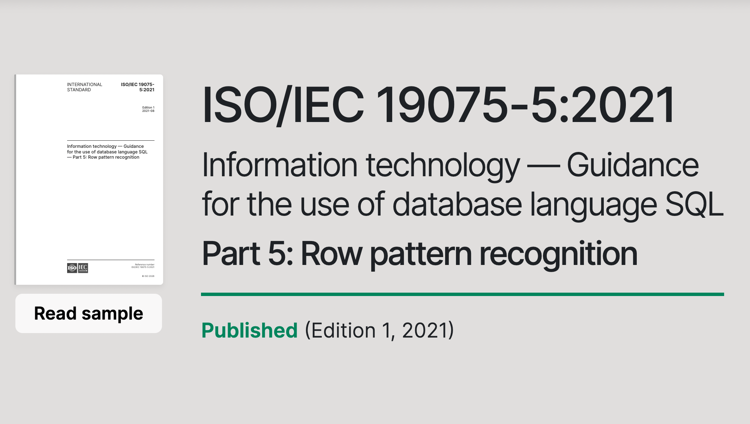
SQL expression of query pattern
In 2016, the International Organization for Standardization (ISO) issued new semantics in SQL to support CER, i.e., Row Pattern Recognition¹. Currently, row pattern recognition is widely implemented in database/data-stream systems such as Oracle, Trino, Flink, Esper, and Snowflake.
SELECT <select list>
FROM <source table>
MATCH_RECOGNIZE (
[ PARTITION BY <partition list> ]
ORDER BY <order by list>
[ MEASURES <measure list>
[ONE ROW | ALL ROWS] PER MATCH
[ AFTER MATCH SKIP <option>]
PATTERN (<row pattern>)
DEFINE <condition definition list>
)
[AS <table alias>]
Row Pattern Recognition in SQL (newest version)
Standard Query Template
¹ More details can refer to https://www.iso.org/standard/78936.html
3
Notes:
In 2016, the ISO issued new semantics in SQL to support CER, namely, Row Pattern Recognition. Currently, row pattern recognition is widely implemented in database and data-stream systems.
注：SQL发音和sequel相同

Slide 4
Example
Suppose we want to query three shapes that appear in chronological order within six seconds: a square, an octagon, and a trapezoid, with the condition that the octagon and trapezoid have equal areas, and those other irrelevant shapes may appear between them.
Schema
SELECT *
FROM shape_table
MATCH_RECOGNIZE (
ORDER BY time
MEASURES shape, area, time
ALL ROWS PER MATCH
AFTER MATCH SKIP TO NEXT ROW
PATTERN (R {-Others*-} B {-Others*-} M)
DEFINE
R AS R.shape = ‘square’,
B AS B.shape = ‘octagon’,
M AS M.shape = ‘trapezoid’
AND M.area = B.area
AND M.time – R.time <= 6
)
CREATE TABLE shape_table(
VARCHAR(16) shape,
DOUBLE area,
long time
)
SQL query
Irrelevant events
Query pattern
Independent condition
Equality condition
6 secs
Window condition
4
Notes:
Here we give an example. Suppose we want to query three shapes that appear in chronological order within six seconds: a square, an octagon, and a trapezoid, with the condition that the octagon and trapezoid have equal areas, and those other irrelevant shapes may appear between them.
The query statement is shown here, where the pattern clause gives the detected pattern. Note that braces are used to support non-contiguous event occurrences, allowing irrelevant events to be skipped. Besides, the define clause gives the conditions on variables.
Currently, there are three types of conditions: an independent condition that can be evaluated on single events, an equality condition that needs to be evaluated on two events, and a window condition that specifies the maximum window distance between the first and last event in the pattern.

Slide 5



Basic concepts: cloud-native
Cloud-native architecture aims to decouple and pool computing and storage resources, enabling independent scaling.
👍 Pros: cost-effectiveness and elastic scalability
👎 Cons: the latency of retrieving data from disk increases significantly
CPU
One/More
Compute
Nodes
CPU
CPU
CPU
The network transmission speed is slower than the PCIe bus.
Memory
Memory Bus
Memory
Memory
Network
Memory
CPU
CPU
PCle Bus
Memory
Memory
Disk
Disk
Disk
EBS or S3
Storage Node
Centralized Node
➀
Storage Node
➁
Monolithic architectures
Cloud-native architectures
5
Notes:
Next, we introduce cloud-native concepts. A cloud-native architecture decouples and pools computing and storage resources, allowing them to scale independently.
Owing to its cost-effectiveness and elastic scalability, an increasing number of database products are migrating to such an environment.
However, there is no free lunch. In a cloud-native environment, the latency for computing resources to retrieve data from disk increases significantly, as network transmission is slower than the PCIe bus.

Slide 6
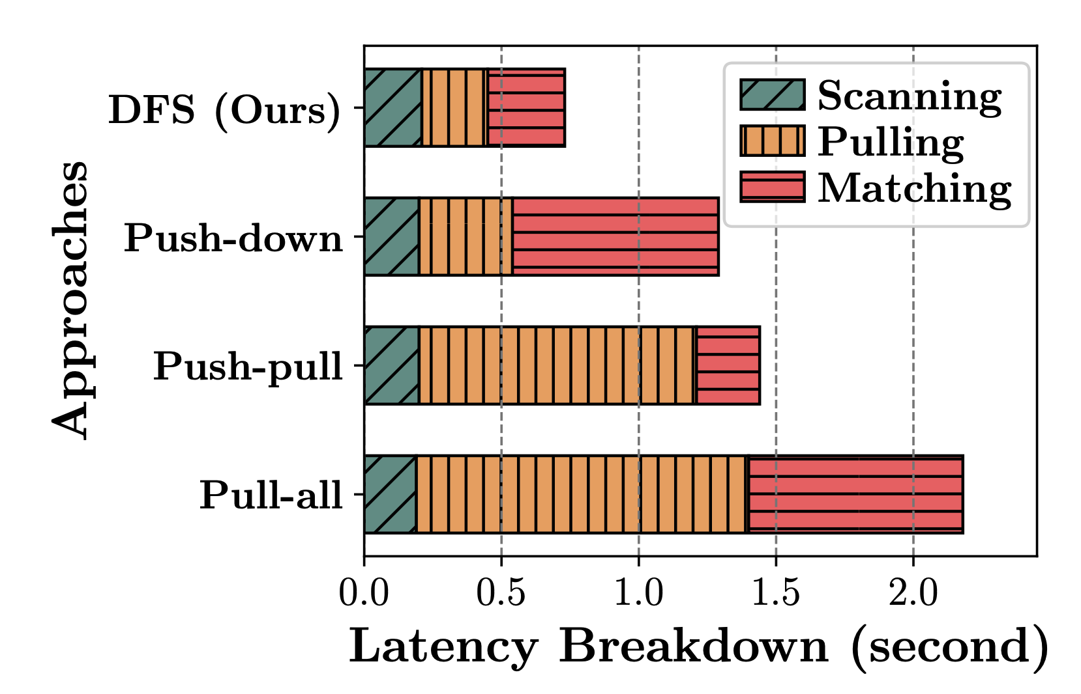


Research Problem
Cloud-native with high availability, high scalability, and low cost ➜ more and more applications are migrating to the cloud-native architecture.
Q: Can we also migrate CER to the cloud native architecture🤔?
A: Sure, but the network will become a performance bottleneck of query.
Complex
Event
Queries
Compute node 1
Compute node n
CER APP
…
CER APP
✄ Network
…
Storage node(s) using EBS or S3
Then, in a cloud-native architecture where computing and storage are separated, the problem for a given query is to design an efficient event-pulling strategy between the storage node and the compute node to minimize query latency.
6
Notes:
Then, in a cloud-native architecture where computing and storage are separated,
the problem that we focus on is given a query, how to design an efficient event-pulling strategy between the storage node and the compute node to minimize query latency.

Slide 7
Prior Approaches
Pull-all: It directly transmits all historical events to the compute node
Push-down (under skipping semantics): It first pushes simple independent conditions to storage nodes, only transmits the events that hold the independent conditions
Push-pull (under skipping semantics): It uses a multi-round transmission mechanism, where each round runs a very time-consuming matching algorithm on the storage node to determine which subset of events needs to be transmitted
Query
pattern
1
2
3
4
5
6
7
8
……
22
23
24
25
26
27
28
29
30
6 secs
Old
New
Retrieve
Storage node
1
2
3
4
5
6
7
8
9
10
11
12
13
14
15
16
17
18
19
20
21
22
23
24
25
26
27
28
29
30
Old
New
7
Notes:
Prior approaches (for example, Pull-all, Push-down, and Push-pull) either transmit a large number of irrelevant events, (翻页)
only work under skipping semantics, (翻页)
or push down expensive filtering operations to the storage nodes.

Slide 8
Prior Approaches
Pull-all: It directly transmits all historical events to the compute node
Push-down (under skipping semantics): It first pushes simple independent conditions to storage nodes, only transmits the events that hold the independent conditions
Push-pull (under skipping semantics): It uses a multi-round transmission mechanism, where each round runs a very time-consuming matching algorithm on the storage node to determine which subset of events needs to be transmitted
Query
pattern
2
6
7
8
10
11
12
13
17
21
22
23
24
26
28
29
30
6 secs
Old
New
Retrieve
Storage node
1
2
3
4
5
6
7
8
9
10
11
12
13
14
15
16
17
18
19
20
21
22
23
24
25
26
27
28
29
30
Old
New
8
Notes:
Prior approaches (for example, Pull-all, Push-down, and Push-pull) either transmit a large number of irrelevant events, (翻页)
only work under skipping semantics, (翻页)
or push down expensive filtering operations to the storage nodes.

Slide 9
Prior Approaches
Pull-all: It directly transmits all historical events to the compute node
Push-down (under skipping semantics): It first pushes simple independent conditions to storage nodes, only transmits the events that hold the independent conditions
Push-pull (under skipping semantics): It uses a multi-round transmission mechanism, where each round runs a very time-consuming matching algorithm on the storage nodes to determine which subset of events needs to be transmitted
Query
pattern
8
23
6
17
2
6 secs
Note that:
area( ) != area( )
23
22
Retrieve
Retrieve
Retrieve
Storage node
1
2
3
4
5
6
7
8
9
10
11
12
13
14
15
16
17
18
19
20
21
22
23
24
25
26
27
28
29
30
Old
New
9
Notes:
Prior approaches (for example, Pull-all, Push-down, and Push-pull) either transmit a large number of irrelevant events, (翻页)
only work under skipping semantics, (翻页)
or push down expensive filtering operations to the storage nodes.

Slide 10

Skipping versus Strict-contiguous
Skipping semantic: Any events are allowed to occur between two specified events
Strict-contiguous semantic: events within the match must be consecutive, with one event directly followed by another
1
3
5
1
2
3
4
5
match
Query pattern 1
 | Skipping |  | Strict-contiguous
 | Effectiveness | Efficiency | Effectiveness | Efficiency
 | ✓ |  | ✓
 | ✓ |  | ✗ | ✕
 | ✓ |  | ✕ | ✕
 | ✓ |  | ✓
2
3
4
6 secs
1
2
3
4
5
Pull-all
match
Push-down
1
2
3
4
5
Push-pull
mismatch
Query pattern 2
Ours
2
3
4
6 secs
1
2
3
4
5
Note that events may arrive out of order, they must be sorted by timestamp before determining the occurrence sequence.
match
Note that dashed lines represent skip semantics and solid lines represent strictly continuous semantics.
10
Notes:
Thus, we wish to design a method that transmits as few irrelevant events as possible, works under both skipping semantics and strict-contiguous semantics, and has low filtering overhead.

Slide 11
Our Core Idea
💡 Our core idea is trying to identify the shortest Time Interval Sets (TIS) that might contain matching results, and only transmit events within these time intervals.
💔 Identifying the shortest TIS has to run matching algorithm, which is time consuming.
To avoid the high overhead of identifying the TIS, we propose a dual-filtering strategy that leverages both temporal and predicate constraints to incrementally shrink the intervals.
Query
pattern
2
6
8
6 secs
Assume we know that only the time interval [2,8] contains a match.
Storage node
1
2
3
4
5
6
7
8
9
10
11
12
13
14
15
16
17
18
19
20
21
22
23
24
25
26
27
28
29
30
Old
New
11
Notes:
Typically, the complex event pattern specified by the user occurs infrequently across the entire event set, meaning that most events are not involved in the final match.
Then, our core idea is trying to identify the shortest Time Interval Set (TIS) that might contain matching results, and only transmit events within these time intervals.
However, identifying the shortest TIS has to run matching algorithm, which is time consuming.
To avoid the high overhead of identifying the TIS, we propose a dual-filtering strategy that leverages both temporal and predicate constraints to incrementally shrink the intervals.

Slide 12
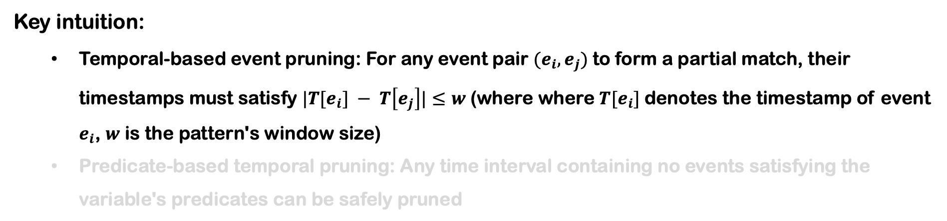
Dual Filtering Strategy (DFS)
Key intuition:
  Temporal-based event pruning: For any event pair $(e_{i}, e_{j})$to form a partial match, their timestamps must satisfy $|T[e_{i}] − T\left[e_{j}\right]|≤w$(where where $T[e_{i}]$denotes the timestamp of event $e_{i}$, $w$ is the pattern's window size)
  Predicate-based temporal pruning: Any time interval containing no events satisfying the variable's predicates can be safely pruned
21
If this event can form a match, then the timestamp range that forms a match with this event must be within [21,27].
Query
pattern
6 secs
If this event can form a match, then the timestamp range that forms a match with this event must be within [17,23].
23
If squre₂₂ and trapezoid₂₃ are a subset of a match, then the timestamp of octagon within the match must be within [21, 23].
12
Notes:
The key intuition of dual-filtering strategy is temporal-based event pruning and predicate-based temporal pruning. Specifically, for any event pair (𝒆_{𝒊}, 𝒆_{𝒋}) to form a partial match, their timestamps must satisfy the window condition.

Slide 13
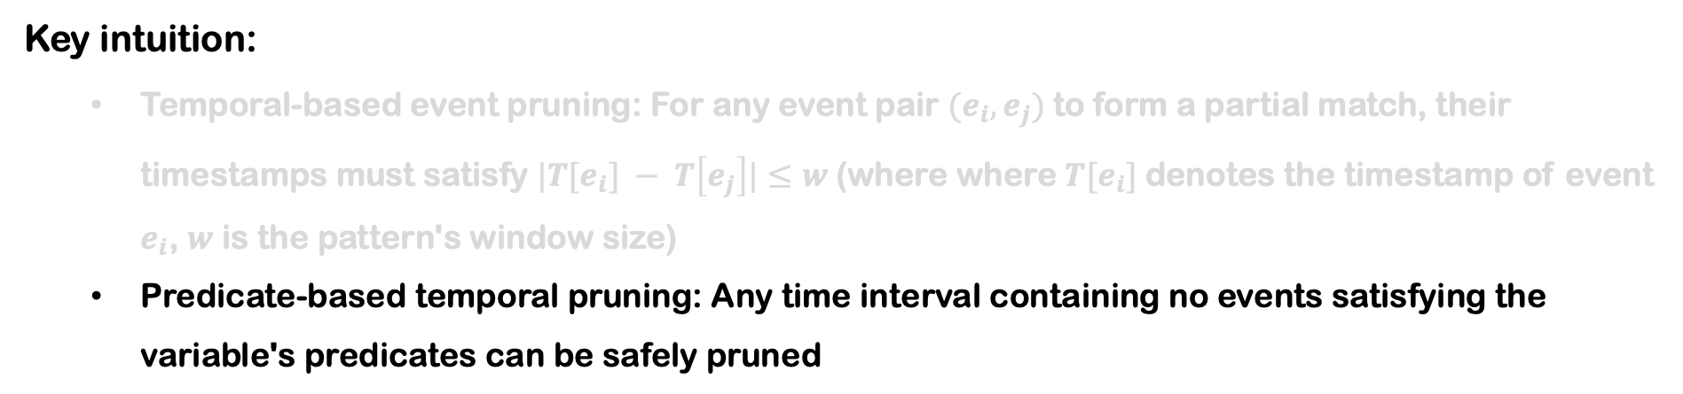
Dual Filtering Strategy (DFS)
Key intuition:
  Temporal-based event pruning: For any event pair $(e_{i}, e_{j})$to form a partial match, their timestamps must satisfy $|T[e_{i}] − T\left[e_{j}\right]|≤w$(where where $T[e_{i}]$denotes the timestamp of event $e_{i}$, $w$ is the pattern's window size)
  Predicate-based temporal pruning: Any time interval containing no events satisfying the variable's predicates can be safely pruned
Since area( ) != area( ), then this interval containing no events satisfying the variable‘s predicates. Then, we do not transmit the events within [21, 23].
21
22
23
23
22
21
23
13
Notes:
And another intuition is any time interval containing no events satisfying the variable's predicates can be safely pruned.

Slide 14





Workflow
When computer node receive a query, it
  initially determines the variable processing order based on the selectivity of variables
  pulls the TIS generated by the first processed variable from the storage nodes
  builds a filter SWF to approximately store TIS
  before pulling a new TIS for an unprocessed variable, CN uses a cost model to estimate whether initiating new round-trip(s) would reduce overall latency
  once TIS generation is complete for all variables, CN sends the local TIS to SNs and pulls events within TIS
  executes the matching algorithm to extract matches from the pulled events
Time
Compute
Node (CN)
Storage
Nodes (SNs)
➀
Complex Event Query
R
1-st Round
…
➁
…
Scan & Filter
Interval Set
Insert
➂
Variable R’s SWF
B
2-nd Round
➃
Filter & Build
...
Incomplete WJF
Merge
➄
Variable B’s WJF
M
3-rd Round
...
➅
Updated SWF
Filter & Update
Merge
➆
Variable M’s SWF
4-th Round
➇
Filtered Events
Filter
Match
Workflow for PATTERN (R {-Others*-} B {-Others*-} M)
14
Notes:
Then, we design a workflow to process the query of CER under cloud-native architectures. Due to time constraints, we won’t go into further detail. Interested audience members can refer to our paper.

Slide 15
Two Specialized Filters – SWF
Motivation of SWF:
  Using an array to maintain TIS has O(N log N) complexity, where N is the number of events. This high complexity may lead to significant latency of round-trips when N is large. Then, we propose the shrinking window filter (SWF) to approximately store time intervals.
Bucket
Slot
0
1
2
3
4
5
interval_tag
0 1 0 1 1 0 0 0 1 1 0
fingerprint
refresh_tag
The fingerprint is a compressed encoding of a time window ID.
The interval_tag marks the time periods that may contain events involved in matching.
The refresh_tag aims to update interval_tag and shrink the time periods.
Illustration for the structure of SWF
15
Notes:
Note that the compute node needs multiple round-trips to pull events.
We design two specialized filters to reduce the latency of these round-trips: the shrinking window filter and the window-wise join filter. (翻页)
The shrinking window filter reduces the complexity of time interval maintenance from O(Nlog N) to O(N).
NlogN 读成 N log N

Slide 16
Key idea of SWF
SWF stores the time interval via fingerprint-based hashing and bitmap techniques. A time range is partitioned into same-sized windows (the windows are stored by fingerprints to save space), each of which is subdivided into fixed-size time slices, and the bitmap of time slices is used to mark the range of time intervals that can be covered.
962037th Window
962038th Window
962039th Window
Time Slice
Time
18:30
19:00
19:30
20:00
Compute Node (CN)
Generate
f₉₆₂₀₃₇
0 1 1
0 0 0
18:45
19:15
f₉₆₂₀₃₈
1 1 0
0 0 0
Storage Node (SN)
Generate
f₉₆₂₀₃₇
0 1 1
1 1 1
f₉₆₂₀₃₈
Entries
18:30
19:00
1 1 0
1 0 0
Storage Node (SN)
Intersect
f₉₆₂₀₃₇
0 1 1
0 0 0
18:45
19:00
f₉₆₂₀₃₈
1 0 0
0 0 0
16
Notes:
Note that the compute node needs multiple round-trips to pull events.
We design two specialized filters to reduce the latency of these round-trips: the shrinking window filter and the window-wise join filter. (翻页)
The shrinking window filter reduces the complexity of time interval maintenance from O(Nlog N) to O(N).
NlogN 读成 N log N

Slide 17

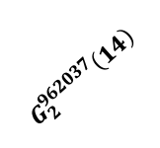
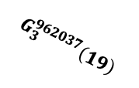
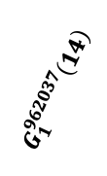
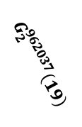
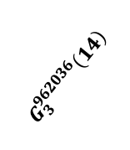
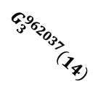

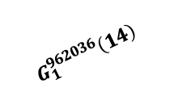
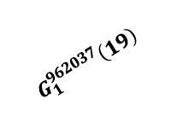
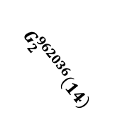

Two Specialized Filters – WJF
Motivation of WJF:
  When processing equality conditions requires the compute node to gather attribute and timestamp information and push them to SNs, leading to an expensive transmission cost.
Then, we design the window-wise join filter (WJF) based on Bloom Filter, to store the set of (attribute, window ID) pairs.
$e_{2}$(district=19, window ID=962037)
Insertion
Phase
$$G_{1}^{962037}\left(19\right)$$
$$G_{3}^{962037}\left(19\right)$$
$$G_{2}^{962037}\left(19\right)$$
WJF
Key idea of WJF:
WJF uses the window ID as the hash seed and the attribute value as the key to calculate k hash positions
0 | 1 | 1 | 1 | 0 | 1 | 0 | 0 | 0 | 1 | 0 | 1 | 0 | 1 | 0 | 1
Query
Phase
$$G_{2}^{962036}\left(14\right)$$
$$G_{3}^{962036}\left(14\right)$$
$$G_{3}^{962037}\left(14\right)$$
$$G_{1}^{962037}\left(14\right)$$
$$G_{2}^{962037}\left(14\right)$$
$$G_{1}^{962036}\left(14\right)$$
$e_{3}$(district=14, window ID= 962036)
$e_{3}$(district=14, window ID= 962037)
17
Illustration for the structure of WJF
Notes:
The window-wise join filter enables low-cost round-trips for processing equality conditions.
In addition, we also designed a cost model to eliminate detrimental round-trips and prevent inefficiencies caused by excessively fine-grained round-trips. We have not presented it here to avoid overwhelming readers with formulas.

Slide 18
Experiments
All experiments are conducted on AWS EC2 instances.
Nodes: one compute node (launched in us-east-1b, with 8 vCPU, 16 GB memory, and a 10 Gbps network bandwidth) and three storage node (launched in us-east-1a, with 4 vCPU, 8 GB memory, and a 10 Gbps network bandwidth).
Storage backend of storage nodes: Amazon S3 or Amazon EBS
Datasets: CRIMES, CITIBIKE, CLUSTER, SYNTHETIC
Baselines: Push-down, Push-pull, Pull-all, Naïve-DFS, Muse
Evaluation engines: SASE, Esper, Flink
18
Notes:
We conduct experiments on AWS EC2 instances to verify the efficiency of our approach. We use Amazon S3 or Amazon EBS as storage backend of storage nodes. We use three evaluation engines: SASE, Esper, and Flink to extract matches.

Slide 19
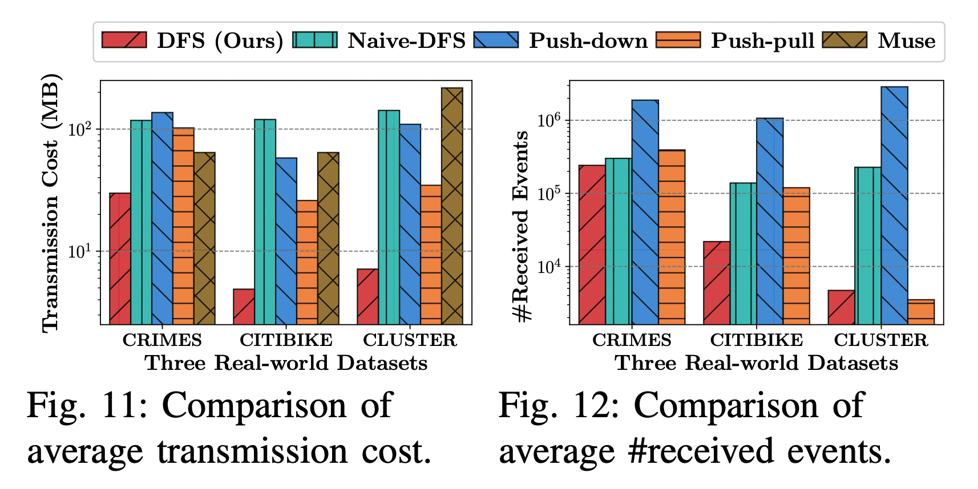
Results for Real-world Datasets
On the three real-world datasets, our approach reduces transmission costs by up to 70% compared with the state-of-the-art approaches.
Comparison of average #received events
Comparison of average transmission cost
19
Notes:
On the three real-world datasets, our approach reduces transmission costs by up to 70% compared with the state-of-the-art approaches.

Slide 20
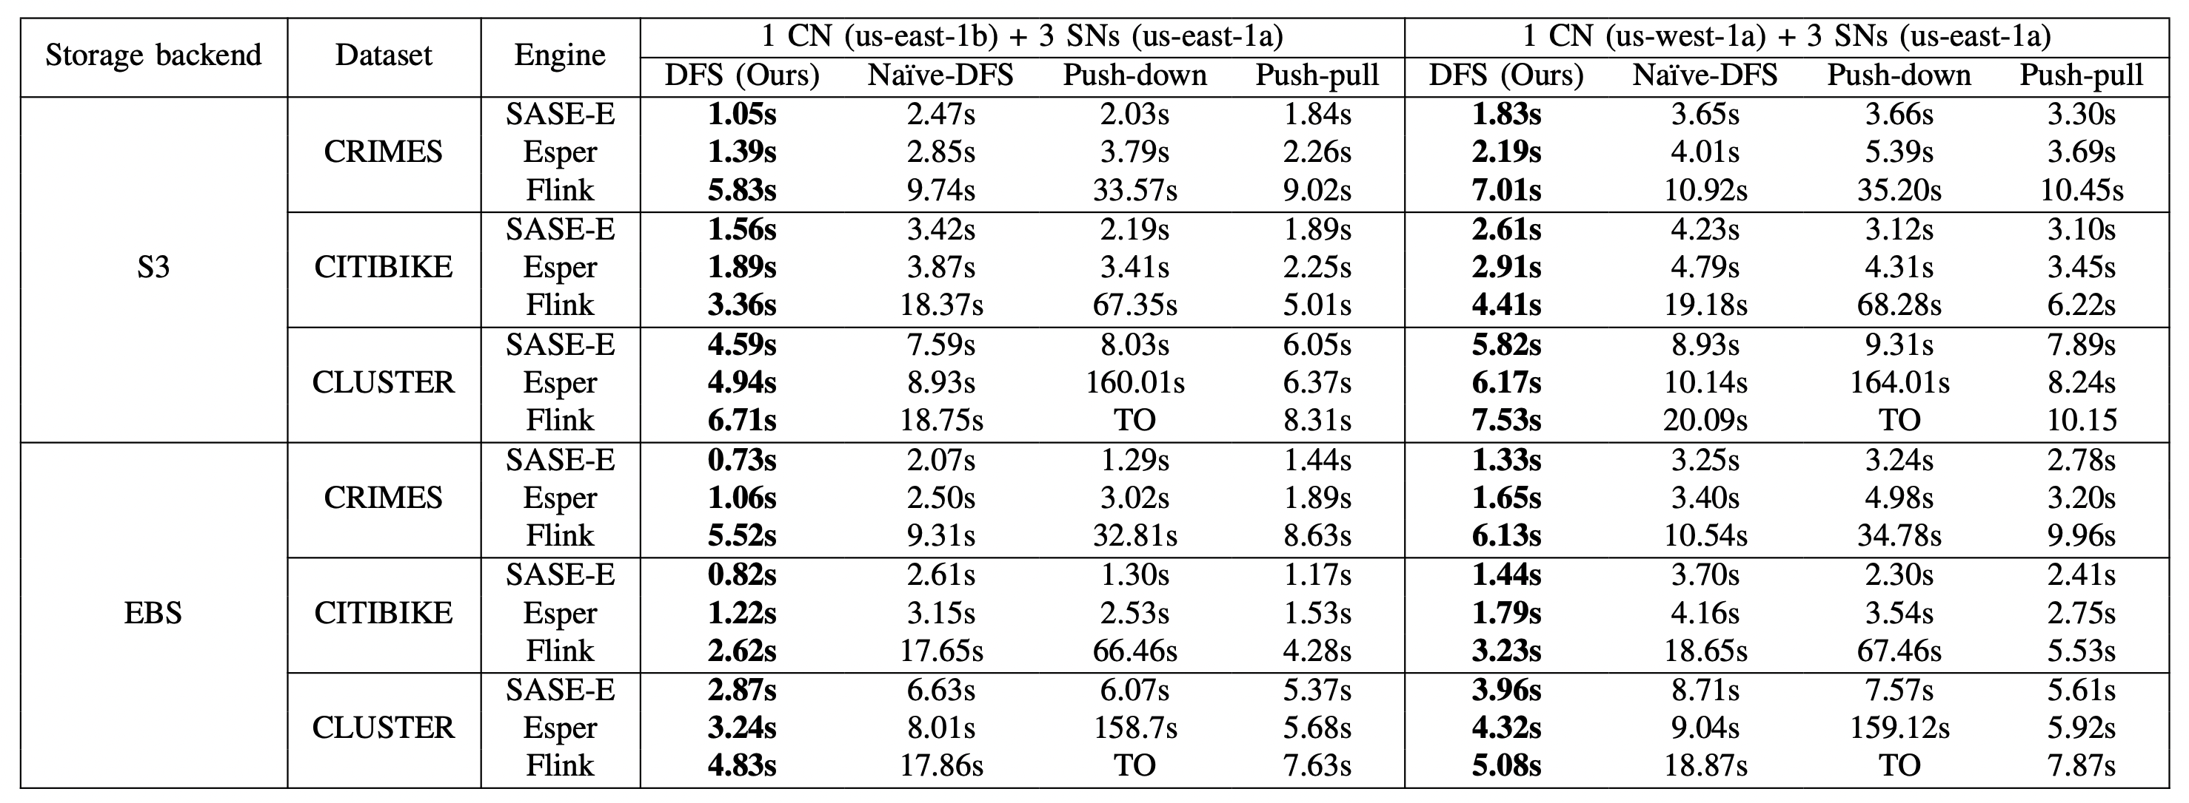
Results for Real-world Datasets
Our approach achieves a 1.2× to 25× speedup across various evaluation engines (e.g., extension of SASE, Esper, and Flink) and storage backends compared with the baselines.
Note that the executed queries with skipping semantics.
20
Notes:
As for the end-to-end latency, our approach achieves a 1.2× to 25× speedup across various evaluation engines and storage backends compared with the baselines. Note that the executed queries with skipping semantics.

Slide 21
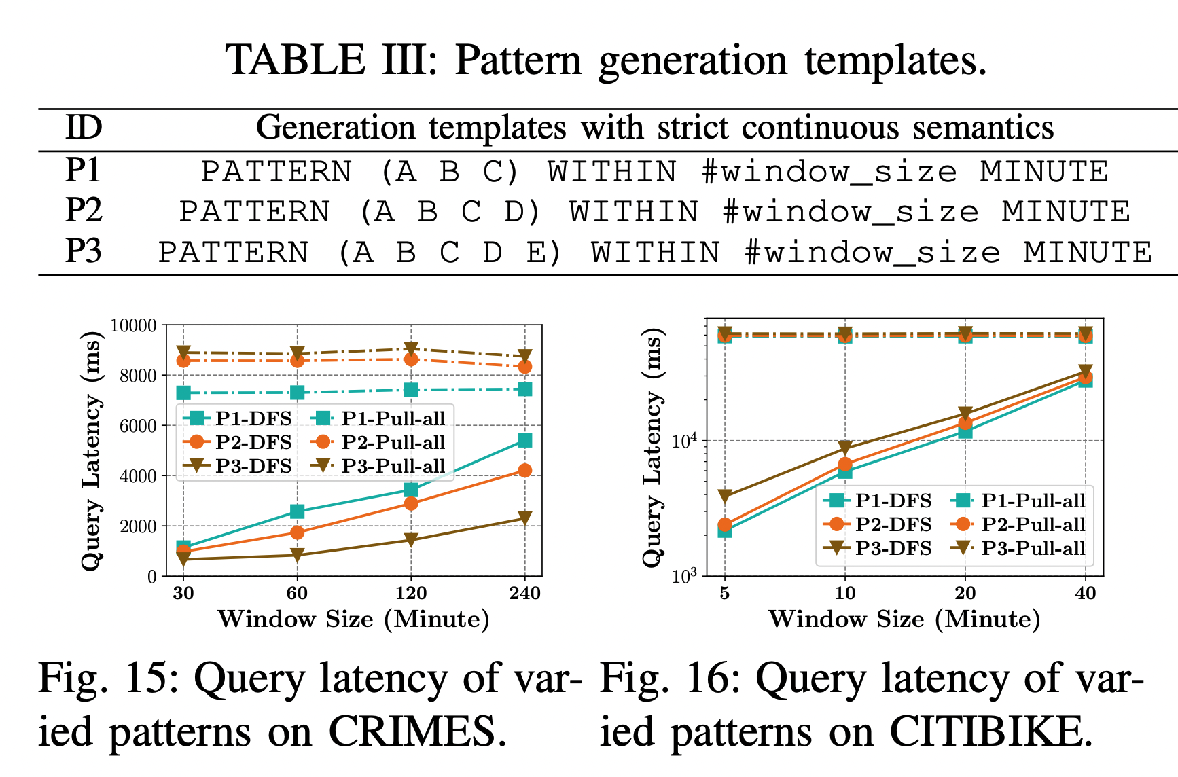
Results for Real-world Datasets
Under strict-contiguous semantics, our approach (DFS) achieves a speedup of 1.5× to 20× over Pull-all.
Pattern generation templates
Query latency of varying patterns on CRIMES
Query latency of varying patterns on CITIBIKE
21
Notes:
Under strict-contiguous semantics, our approach achieves a speedup of 1.5× to 20× over Pull-all.

Slide 22
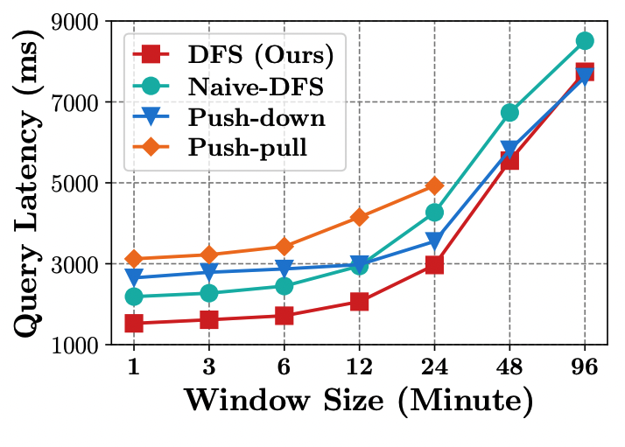
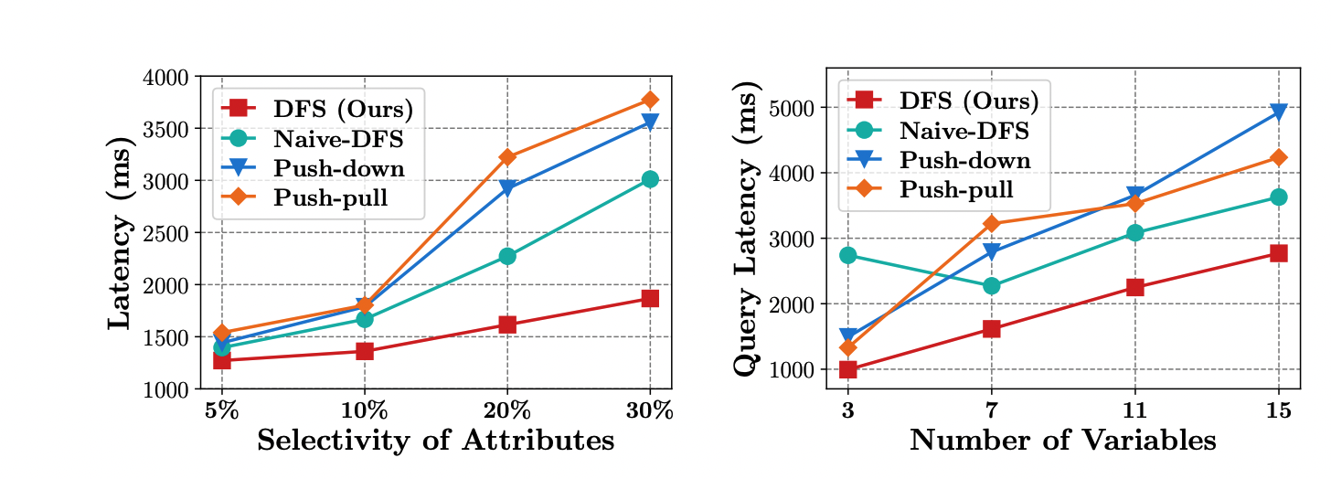
Results for Synthetic Dataset
The longer windows increase the number of events involved in matching, thereby reducing the effectiveness of pruning and increasing the matching time
As attribute selectivity increases, more events are transmitted, increasing query latency
As the number of variables increases, the cost of checking independent conditions rises, increasing scanning overhead for all approaches.
Query latency under varying window size, attribute selectivity, and number of variables
22
Notes:
On the synthetic dataset, we investigate the effects of different window sizes, selectivity, and numbers of variables on query latency, and our approach consistently achieves the lowest latency.

Slide 23
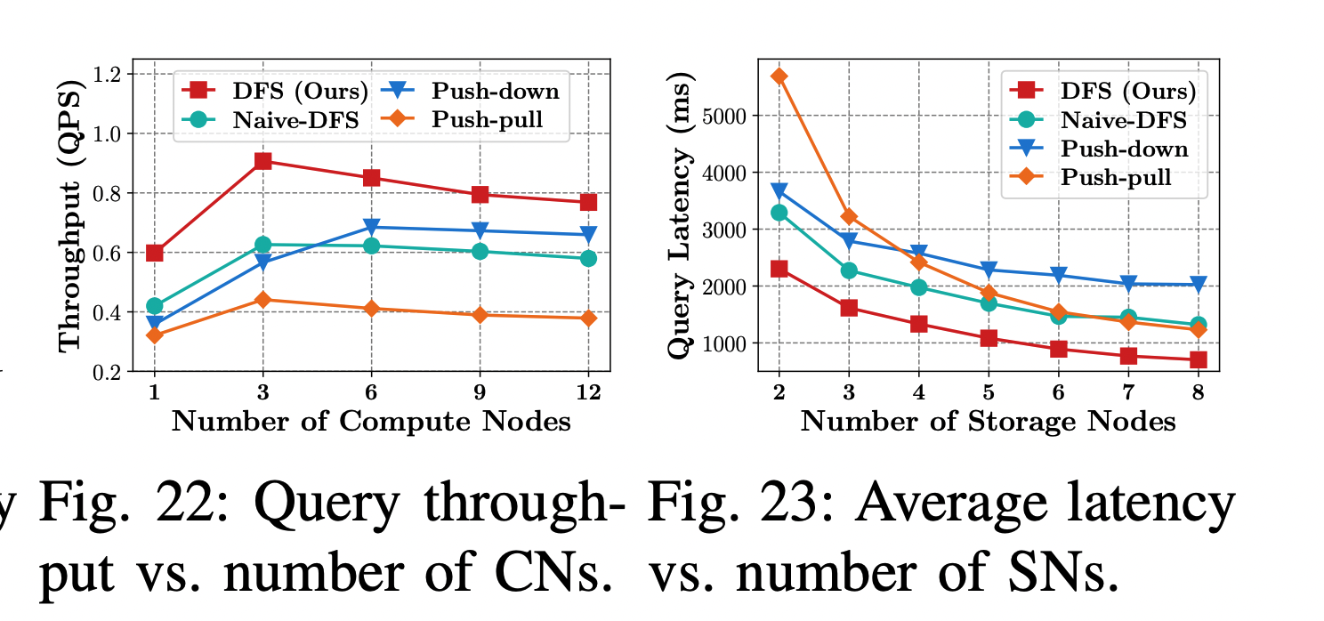
Results for Synthetic Dataset
DFS achieves the largest throughput gain when scaling the number of compute nodes
  As the number of CNs increases further, rapid saturation of network bandwidth and memory resources diminishes the benefits of parallelism
DFS consistently achieves the lowest latency when scaling the number of storage nodes
  Increasing the number of storage nodes improves parallelism in data loading ➜ lower query latency
Query throughput vs. number of CNs
Average latency vs. number of SNs
23
Notes:
We also conducted scalability experiments. The results show that our approach achieves the largest throughput gain when scaling the number of compute nodes, and consistently achieves the lowest latency when scaling the number of storage nodes.

Slide 24
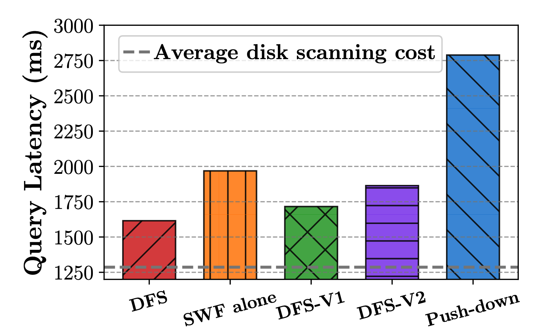
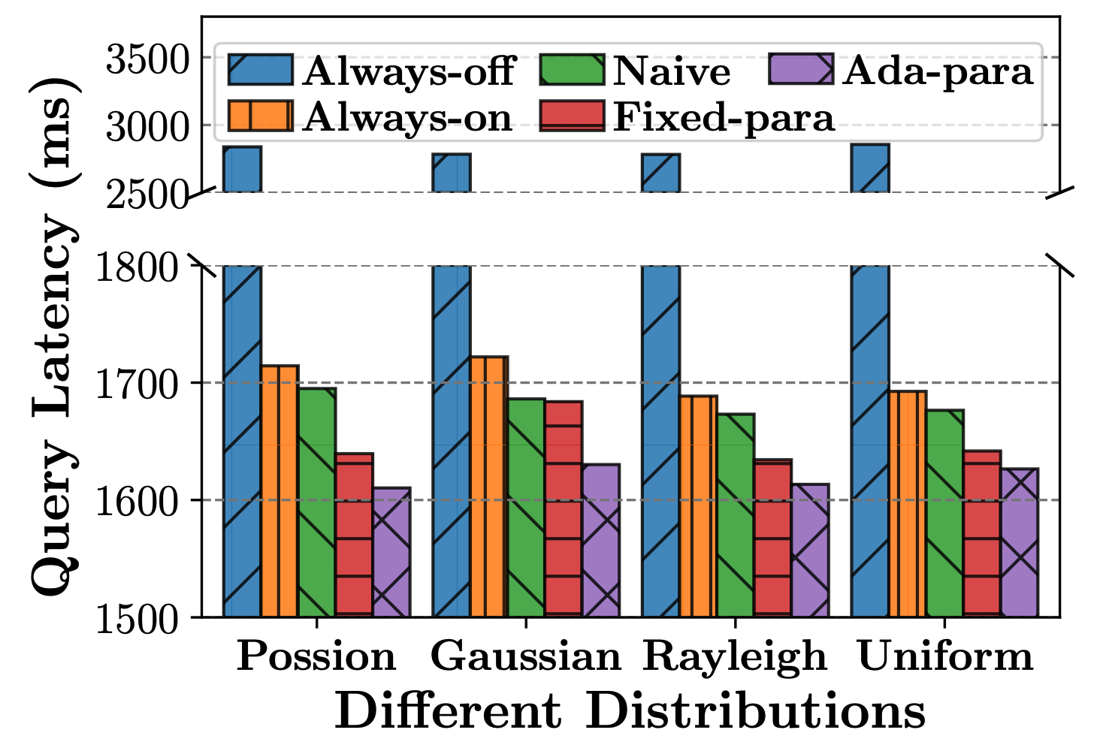
Ablation Studies on Synthetic Dataset
SWF and WJF contribute to latency reduction
  SWF alone: disabling WJF in all round-trips
  DFS-V1: replacing WJF with a hash table
  DFS-V2: replacing SWF and WJF with naive interval array and hash table, respectively
Proposed cost model (ada-para) yields the lowest latency for DFS since it can eliminate detrimental round-trips
Ablation studies of system components
Average latency vs. varying cost models
24
Notes:
Finally, our ablation experiments show that all components, namely SWF, WJF, and the cost model, can reduce query latency.

Slide 25
Conclusion
When complex event recognition (CER) operates in cloud-native architectures, the network becomes a performance bottleneck
Our key insight is to identify shorter time intervals that contain matches and only transmit the events within those intervals
Our approach achieves a 1.2× to 25× query speedup compared with the SOTA
Complex
Event
Queries
Compute node 1
Compute node n
CER APP
…
CER APP
Try to reduce the transmission of query-irrelevant events at the lowest possible cost.
✄ Network
…
Storage node(s) using EBS or S3
25
Notes:
In conclusion, when CER operates in cloud-native architectures, the network becomes a performance bottleneck, and our key insight is to reduce the transmission of query-irrelevant events at the lowest possible cost.

Slide 26
Thank You! ❤️
Shizhe Liu
Nanjing University
✉️
shizheliu@smail.nju.edu.cn
Notes:
That’s all, thank you.

