Slide 1






When Complex Event Recognition Meets Cloud-Native Architectures
Shizhe Liu¹, Haipeng Dai¹, Meng Li¹, Yuemeng Zhang¹, Shaoxu Song²,
Zhifeng Bao³, Hancheng Wang¹, Xiaofeng Gao⁴, Guihai Chen¹
Nanjing
University¹
Tsinghua
University²
The University
of Queensland³
Shanghai Jiao
Tong University⁴
Notes:
Hello, everyone. I am Shizhe Liu, a Ph.D. student from Nanjing University.

Slide 2
Basic concepts: complex event recognition
Complex event recognition (CER) aims to detect a predefined pattern composed of multiple primitive events.
Event set (assuming a time interval of 1 second between events)
1
2
3
4
5
6
7
8
9
10
11
12
13
14
15
16
17
18
19
20
21
22
23
24
25
26
27
28
29
30
Old
New
Retrieve
Query pattern
Match(es)
( , , )
2
6
8
6 secs
( , , )
21
22
23
Pattern commonly specifies:
(1) the constraints on event attribute values;
(2) the event temporal order;
(3) the maximum distance between the earliest and latest events.
2
Notes:
Pattern commonly specifies:
(1) the constraints on event attribute values, e.g., figure shape;
(2) the event temporal order, e.g., the octagon is behind the square, and there may be other shapes between the two shapes;
(3) the maximum distance between the earliest and latest events, e.g., the timestamp of the trapezoid is less than 6 seconds apart from that of the square.

Slide 3
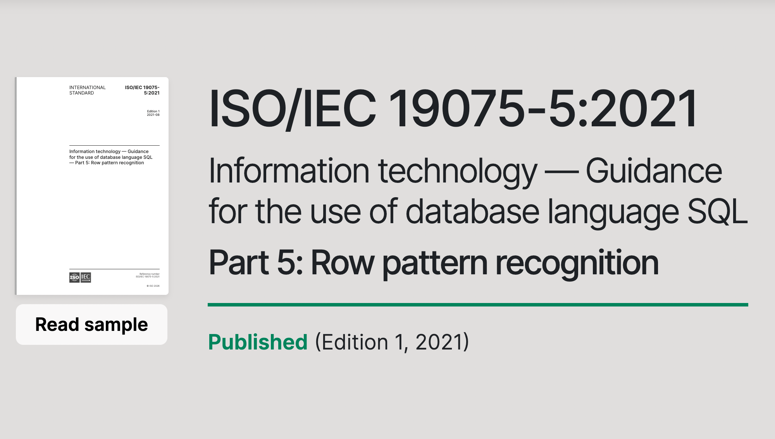
SQL expression of query pattern
In 2016, the International Organization for Standardization issued new semantics in SQL to support CER, i.e., Row Pattern Recognition¹. Currently, row pattern recognition has widely implemented by database/data-stream systems such as Oracle, Trino, Flink, and Esper.
SELECT <select list>
FROM <source table>
MATCH_RECOGNIZE (
[ PARTITION BY <partition list> ]
ORDER BY <order by list>
[ MEASURES <measure list>
[ONE ROW | ALL ROWS] PER MATCH
[ AFTER MATCH SKIP <option>]
PATTERN (<row pattern>)
DEFINE <condition definition list>
)
[AS <table alias>]
Row Pattern Recognition in SQL (newest version)
Standard Query Template
¹ More details can refer to https://www.iso.org/standard/78936.html
3

Slide 4
Example
Suppose we want to query three shapes appearing in chronological order within six seconds: a square, an octagon, and a trapezoid, with the condition that the octagon and trapezoid have equal areas, and other unrelated shapes may appear between them.
Schema
SELECT *
FROM shape_table
MATCH_RECOGNIZE (
ORDER BY time
MEASURES shape, area, time
ALL ROWS PER MATCH
AFTER MATCH SKIP TO NEXT ROW
PATTERN (R {-Others*-} B {-Others*-} M)
DEFINE
R AS R.shape = ‘square’,
B AS B.shape = ‘octagon’,
M AS M.shape = ‘trapezoid’
AND M.area = B.area
AND M.time – R.time <= 6
)
CREATE TABLE shape_table(
VARCHAR(16) shape,
DOUBLE area,
long time
)
SQL query
Query pattern
Independent condition
Equality condition
6 secs
Window condition
4

Slide 5



Basic concepts: cloud-native
Cloud-native architecture aims to decouple and pool computing and storage resources, enabling independent scaling.
👍 Pros: cost-effectiveness and elastic scalability
👎 Cons: the latency of retrieving data from disk increases significantly
CPU
One/More
Compute
Nodes
CPU
CPU
CPU
The network transmission speed is slower than the PCIe bus.
Memory
Memory Bus
Memory
Memory
Network
Memory
CPU
CPU
PCle Bus
Memory
Memory
Disk
Disk
Disk
EBS or S3
Storage Node
Centralized Node
➀
Storage Node
➁
Monolithic architectures
Cloud-native architectures
5
Notes:
Since it offers cost-effectiveness and elastic scalability, an increasing number of database products are migrating to this environment.
However, there is no such thing as a free lunch.
When migrating to a cloud-native environment, the latency for computing resources to retrieve data from disk increases significantly,
because network transmission speeds are slower than the PCIe bus.

Slide 6
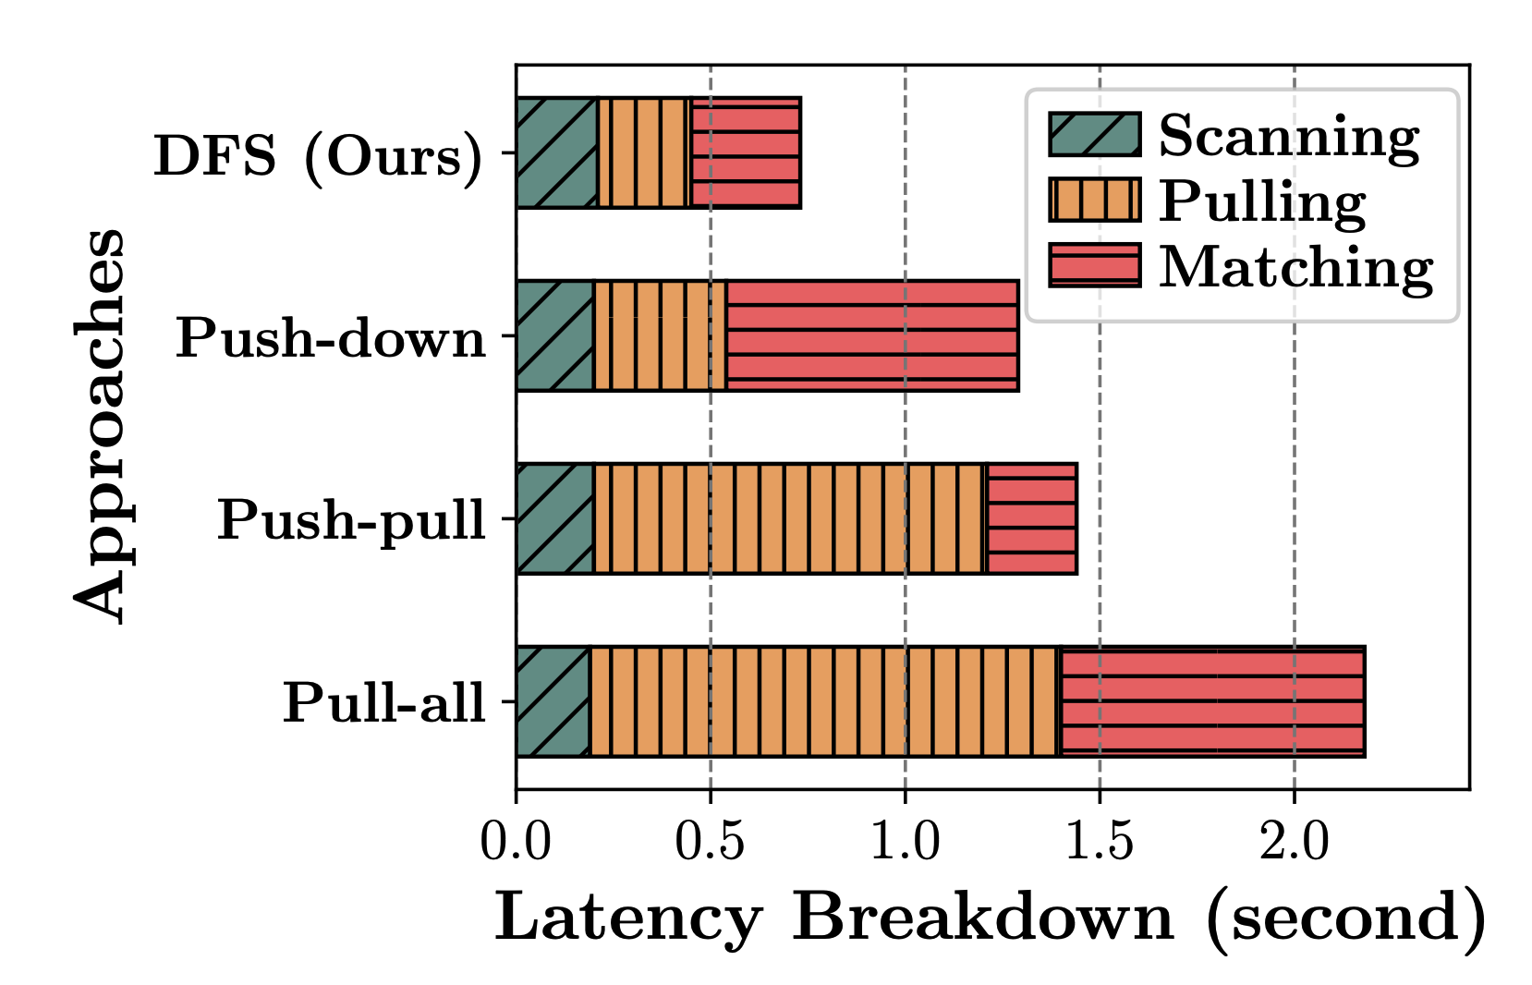


Research Problem
Cloud-native with high availability, high scalability, and low cost ➜ more and more applications are migrating to the cloud-native architecture.
Q: Can we also migrate CER to the cloud native architecture🤔?
A: Sure, but the network will become a performance bottleneck of query.
Complex
Event
Queries
Compute node 1
Compute node n
CER APP
…
CER APP
✄ Network
…
Distributed/Shared storage (EBS or S3)
Then, in a cloud-native architecture where computing and storage are separated, the problem for a given query is to design an efficient event-pulling strategy between the storage node and the compute node to minimize query latency.
6
Notes:
In this paper, our research problem is:
in a cloud-native architecture where computing and storage are separated, for a given query,
how to design an efficient event-pulling strategy between the storage node and the compute node to minimize query latency.

Slide 7
Prior Approaches
Pull-all: It directly transmits all historical events to the compute node
Push-down (under skipping semantics): It first pushes simple independent conditions to storage nodes, only transmits the events that hold the independent conditions
Push-pull (under skipping semantics): It uses a multi-round transmission mechanism, where each round runs a very time-consuming matching algorithm on the storage node to determine which subset of events needs to be transmitted
Query
pattern
1
2
3
4
5
6
7
8
……
22
23
24
25
26
27
28
29
30
6 secs
Old
New
Retrieve
Storage node
1
2
3
4
5
6
7
8
9
10
11
12
13
14
15
16
17
18
19
20
21
22
23
24
25
26
27
28
29
30
Old
New
7
Notes:
It directly transmits all historical events to the compute node, completely blocking the performance advantages of cloud-native architectures.
Only pushes simple independent conditions to storage nodes, completely ignoring temporal windows and cross-variable dependencies, still leading to massive irrelevant events being uploaded.
Relies on expensive multi-round iterative transmissions and requires storage nodes to execute high-cost matching algorithms, heavily consuming scarce CPU and memory resources of storage nodes.

Slide 8
Prior Approaches
Pull-all: It directly transmits all historical events to the compute node
Push-down (under skipping semantics): It first pushes simple independent conditions to storage nodes, only transmits the events that hold the independent conditions
Push-pull (under skipping semantics): It uses a multi-round transmission mechanism, where each round runs a very time-consuming matching algorithm on the storage node to determine which subset of events needs to be transmitted
Query
pattern
2
6
7
8
10
11
12
13
17
21
22
23
24
26
28
29
30
6 secs
Old
New
Retrieve
Storage node
1
2
3
4
5
6
7
8
9
10
11
12
13
14
15
16
17
18
19
20
21
22
23
24
25
26
27
28
29
30
Old
New
8
Notes:
It directly transmits all historical events to the compute node, completely blocking the performance advantages of cloud-native architectures.
Only pushes simple independent conditions to storage nodes, completely ignoring temporal windows and cross-variable dependencies, still leading to massive irrelevant events being uploaded.
Relies on expensive multi-round iterative transmissions and requires storage nodes to execute high-cost matching algorithms, heavily consuming scarce CPU and memory resources of storage nodes.

Slide 9
Prior Approaches
Pull-all: It directly transmits all historical events to the compute node
Push-down (under skipping semantics): It first pushes simple independent conditions to storage nodes, only transmits the events that hold the independent conditions
Push-pull (under skipping semantics): It uses a multi-round transmission mechanism, where each round runs a very time-consuming matching algorithm on the storage nodes to determine which subset of events needs to be transmitted
Query
pattern
8
23
6
17
2
6 secs
Note that:
area( ) != area( )
23
22
Retrieve
Retrieve
Retrieve
Storage node
1
2
3
4
5
6
7
8
9
10
11
12
13
14
15
16
17
18
19
20
21
22
23
24
25
26
27
28
29
30
Old
New
9
Notes:
It directly transmits all historical events to the compute node, completely blocking the performance advantages of cloud-native architectures.
Only pushes simple independent conditions to storage nodes, completely ignoring temporal windows and cross-variable dependencies, still leading to massive irrelevant events being uploaded.
Relies on expensive multi-round iterative transmissions and requires storage nodes to execute high-cost matching algorithms, heavily consuming scarce CPU and memory resources of storage nodes.

Slide 10

Skipping versus Strict-contiguous
Skipping semantic: Any events are allowed to occur between two specified events
Strict-contiguous semantic: events within the match must be consecutive, with one event directly followed by another
1
3
5
1
2
3
4
5
match
Query pattern 1
 | Skipping |  | Strict-contiguous
 | Effectiveness | Efficiency | Effectiveness | Efficiency
 | ✓ |  | ✓
 | ✓ |  | ✗ | ✕
 | ✓ |  | ✕ | ✕
 | ✓ |  | ✓
2
3
4
6 secs
1
2
3
4
5
Pull-all
match
Push-down
1
2
3
4
5
Push-pull
mismatch
Query pattern 2
Ours
2
3
4
6 secs
1
2
3
4
5
Note that events may arrive out of order, they must be sorted by timestamp before determining the occurrence sequence.
match
Note that dashed lines represent skip semantics and solid lines represent strictly continuous semantics.
10
Notes:
Considering the possibility that events may arrive out of order, they must be sorted by timestamp before determining the sequence in which they occurred.

Slide 11
Our Core Idea
💡 Our core idea is try to identify the shortest Time Interval Sets (TIS) that might contain matching results, and only transmit events within these time intervals.
💔 Identifying the shortest TIS has to run matching algorithm, which is time consuming.
To circumvent the high overhead in identifying the TIS, we propose a dual-filtering strategy that synergistically leverages both temporal and predicate constraints to shrink the intervals.
Query
pattern
2
6
8
6 secs
Assume we know that only the time interval [2,8] contains a match.
Storage node
1
2
3
4
5
6
7
8
9
10
11
12
13
14
15
16
17
18
19
20
21
22
23
24
25
26
27
28
29
30
Old
New
11
Notes:
Commonly, the complex event pattern specified by the user occurs infrequently across the entire event set, meaning that most events are not involved in the final match. Thus,
Dual Filtering Strategy (DFS)
Iterative Interval Shrinking
Through lightweight multi-round communication between CN and SN, we built a "Time + Predicate" dual filtering mechanism.
Upon receiving candidate time intervals, storage nodes first eliminate expired events outside the time range. Furthermore, using equivalence dependency conditions, time slices that cannot form valid matches are eliminated, achieving step-by-step interval shrinking and minimizing the final transmitted data volume.

Slide 12
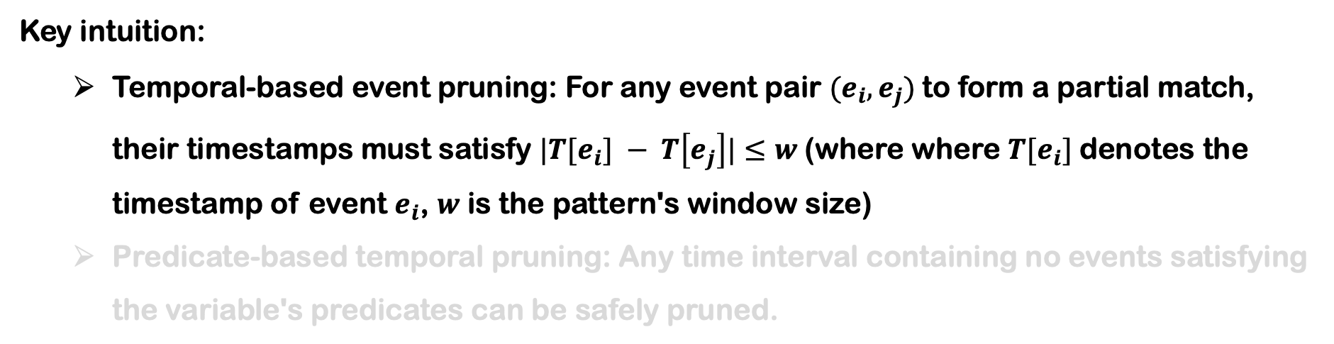
Dual Filtering Strategy (DFS)
Key intuition:
Temporal-based event pruning: For any event pair $(e_{i}, e_{j})$to form a partial match, their timestamps must satisfy $|T[e_{i}] − T\left[e_{j}\right]|≤w$(where where $T[e_{i}]$denotes the timestamp of event $e_{i}$, $w$ is the pattern's window size)
Predicate-based temporal pruning: Any time interval containing no events satisfying the variable's predicates can be safely pruned.
8
If this event can form a match, then the timestamp range that forms a match with this event must be within [2,8].
Query
pattern
6 secs
If this event can form a match, then the timestamp range that forms a match with this event must be within [17,23].
23
12
Notes:
Filter data structures can approximately indicate whether an element is in a given set. For example, the cuckoo filter saves fingerprints in a hash table.

Slide 13
Dual Filtering Strategy (DFS)
Key intuition:
Temporal-based event pruning: For any event pair $(e_{i}, e_{j})$to form a partial match, their timestamps must satisfy $|T[e_{i}] − T\left[e_{j}\right]|≤w$(where where $T[e_{i}]$denotes the timestamp of event $e_{i}$, $w$ is the pattern's window size)
Predicate-based temporal pruning: Any time interval containing no events satisfying the variable's predicates can be safely pruned.
21
If this event can form a match, then the timestamp range that forms a match with this event must be within [21,28].
Query
pattern
6 secs
If this event can form a match, then the timestamp range that forms a match with this event must be within [17,23].
23
If squre₂₂ and trapezoid₂₃ are a subset of a match, then the timestamp of octagon within the match must be within [21, 23].
13
Notes:
Filter data structures can approximately indicate whether an element is in a given set. For example, the cuckoo filter saves fingerprints in a hash table.

Slide 14
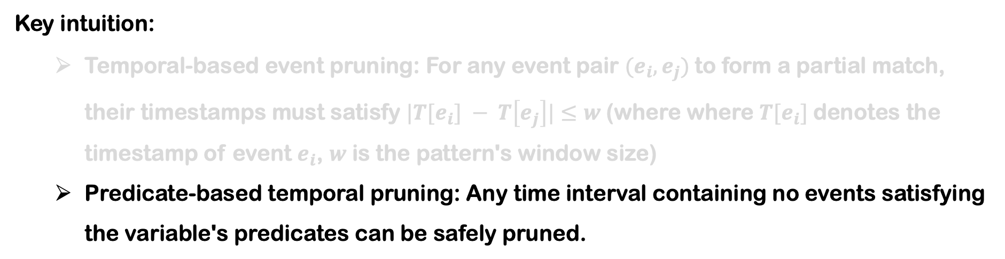
Dual Filtering Strategy (DFS)
Key intuition:
Temporal-based event pruning: For any event pair $(e_{i}, e_{j})$to form a partial match, their timestamps must satisfy $|T[e_{i}] − T\left[e_{j}\right]|≤w$(where where $T[e_{i}]$denotes the timestamp of event $e_{i}$, $w$ is the pattern's window size)
Predicate-based temporal pruning: Any time interval containing no events satisfying the variable's predicates can be safely pruned.
Since area( ) != area( ), then this interval containing no events satisfying the variable‘s predicates. Then, we do not transmit the events within [21, 23].
21
22
23
23
22
21
23
14
Notes:
Filter data structures can approximately indicate whether an element is in a given set. For example, the cuckoo filter saves fingerprints in a hash table.

Slide 15





Workflow
When computer node receive a query, it
initially determines the variable processing order based on the selectivity of variables
pulls the TIS generated by the first processed variable from the storage nodes
builds a filter SWF to approximately store TIS
before pulling a new TIS for an unprocessed variable, CN uses a cost model to estimate whether initiating new round-trip(s) would reduce overall latency
once TIS generation is complete for all variables, CN sends the local TIS to SNs and pulls events within TIS
executes the matching algorithm to extract matches from the pulled events
Time
Compute
Node (CN)
Storage
Nodes (SNs)
➀
Complex Event Query
R
1-st Round
…
➁
…
Scan & Filter
Interval Set
Insert
➂
Variable R’s SWF
B
2-nd Round
➃
Filter & Build
...
Incomplete WJF
Merge
➄
Variable B’s WJF
M
3-rd Round
...
➅
Updated SWF
Filter & Update
Merge
➆
Variable M’s SWF
4-th Round
➇
Filtered Events
Filter
Match
Workflow for PATTERN (R {-Others*-} B {-Others*-} M)
15
Notes:
CN initially determines the variable processing order based on the selectivity of variables in the query pattern and pulls the TIS generated by the first processed variable from SNs. Next, the CN builds SWF to approximately store TIS, enabling efficient filtering and updates during subsequent processes. Although we use SWF, we refer to this as TIS for consistency. Before pulling a new TIS for an unprocessed variable, CN uses a cost model to estimate whether initiating new round-trip(s) would reduce overall latency. If yes, CN sends the local TIS to SNs for filtering and pulls the updated TIS (if the current variable has equality conditions with previously processed ones, an extra round-trip is initiated to collect attribute and timestamp information). Otherwise, it skips generating a new TIS for that variable and moves on to other unprocessed variables.

Slide 16
Two Specialized Filters – SWF
Motivation of SWF:
Using an array to maintain TIS has O(N log N) complexity, where N is the number of events. This high complexity may lead to significant latency of round-trips when N is large. Then, we propose the shrinking window filter (SWF) to approximately store time intervals.
Bucket
Slot
0
1
2
3
4
5
interval_tag
0 1 0 1 1 0 0 0 1 1 0
fingerprint
refresh_tag
The fingerprint is a compressed encoding of a time window ID.
The interval_tag marks the time periods that may contain events involved in matching.
The refresh_tag aims to update interval_tag and shrink the time periods.
Illustration for the structure of SWF
16
Notes:
two specialized filters: the shrinking window filter which reduces the complexity of time intervals maintenance from O(N log N) to O(N), and the window-wise join filter, which enables lowcost round-trips for processing equality conditions.

Slide 17
Key idea of SWF
SWF stores the time interval via fingerprint-based hashing and bitmap techniques. A time range is partitioned into same-sized windows (the windows are stored by fingerprints to save space), each of which is subdivided into fixed-size time slices, and the bitmap of time slices is used to mark the range of time intervals that can be covered.
962037th Window
962038th Window
962039th Window
Time Slice
Time
18:30
19:00
19:30
20:00
Compute Node (CN)
Generate
f₉₆₂₀₃₇
0 1 1
0 0 0
18:45
19:15
f₉₆₂₀₃₈
1 1 0
0 0 0
Storage Node (SN)
Generate
f₉₆₂₀₃₇
0 1 1
1 1 1
f₉₆₂₀₃₈
Entries
18:30
19:00
1 1 0
1 0 0
Storage Node (SN)
Intersect
f₉₆₂₀₃₇
0 1 1
0 0 0
18:45
19:00
f₉₆₂₀₃₈
1 0 0
0 0 0
17
Notes:
two specialized filters: the shrinking window filter which reduces the complexity of time intervals maintenance from O(N log N) to O(N), and the window-wise join filter, which enables lowcost round-trips for processing equality conditions.

Slide 18

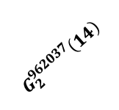
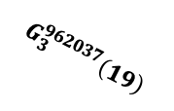
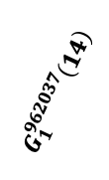
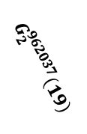
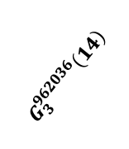
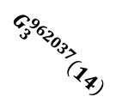

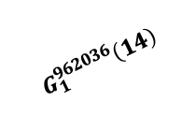
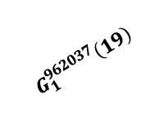
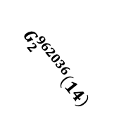

Two Specialized Filters – WJF
Motivation of WJF:
When processing equality conditions requires the compute node to gather attribute and timestamp information and push them to SNs, leading to an expensive transmission cost.
Then, we design the window-wise join filter (WJF) based on Bloom Filter, to store the set of (attribute, window ID) pairs.
$e_{2}$(district=19, window ID=962037)
Insertion
Phase
$$G_{1}^{962037}\left(19\right)$$
$$G_{3}^{962037}\left(19\right)$$
$$G_{2}^{962037}\left(19\right)$$
WJF
Key idea of WJF:
WJF uses the window ID as the hash seed and the attribute value as the key to calculate k hash positions
0 | 1 | 1 | 1 | 0 | 1 | 0 | 0 | 0 | 1 | 0 | 1 | 0 | 1 | 0 | 1
Query
Phase
$$G_{2}^{962036}\left(14\right)$$
$$G_{3}^{962036}\left(14\right)$$
$$G_{3}^{962037}\left(14\right)$$
$$G_{1}^{962037}\left(14\right)$$
$$G_{2}^{962037}\left(14\right)$$
$$G_{1}^{962036}\left(14\right)$$
$e_{3}$(district=14, window ID= 962036)
$e_{3}$(district=14, window ID= 962037)
18
Illustration for the structure of WJF
Notes:
we design the window-wise join filter based on BF [34], to store the set of (attribute, window ID) pairs. Specifically, WJF contains a bit array and k independent hash functions G ξ 1 (·), · · · , Gξ k (·) obeying uniform distribution, where ξ is the hash seed. Initially, all bits in the bit array are set to 0. When inserting a (attribute, window ID) pair to WJF, WJF uses the window ID as the hash seed and the attribute value as the key to calculate k hash positions. Then, WJF sets the bit values of k mapped position to 1.
WJF uses the window ID as the hash seed and the attribute value as the key to calculate k hash positions

Slide 19
Experiments
All experiments are conducted on AWS EC2 instances.
Nodes: one compute node (launched in us-east-1b, with 8 vCPU, 16 GB memory, and a 10 Gbps network bandwidth) and three storage node (launched in us-east-1a, with 4 vCPU, 8 GB memory, and a 10 Gbps network bandwidth).
Storage backend of storage node: Amazon S3 or Amazon EBS
Datasets: CRIMES, CITIBIKE, CLUSTER, SYNTHETIC
Baselines: Push-down, Push-pull, Pull-all
Matching engines: SASE, Esper, Flink
19
Notes:
Filter data structures can approximately indicate whether an element is in a given set. For example, the cuckoo filter saves fingerprints in a hash table.

Slide 20
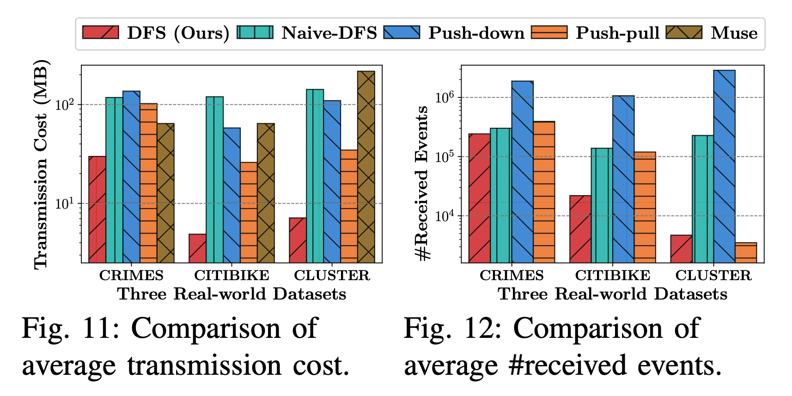
Results for Real-world Datasets
Although Push-pull makes the most use of filtering conditions, the number of events it receives from multi-round matching is not significantly superior to our approach;
Our approach reduces transmission costs by up to 70% on three real-world datasets
Comparison of average #received events
Comparison of average transmission cost
20
Notes:
Comparison of average transmission cost.
.

Slide 21
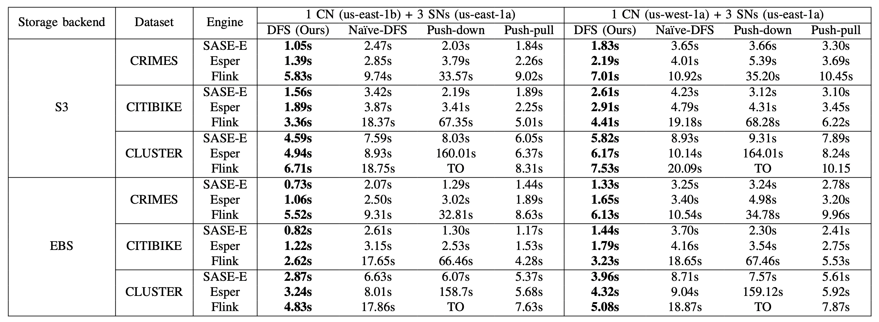
Results for Real-world Datasets
Our approach achieves a 1.2× to 25× speedup across various evaluation engines (e.g., extension of SASE, Esper, and Flink) and storage backends compared with the baselines.
Note that the executed queries with skipping semantics.
21
Notes:
DFS achieves a 1.2× to 25× speedup across various evaluation engines and storage backends compared with the baselines.

Slide 22
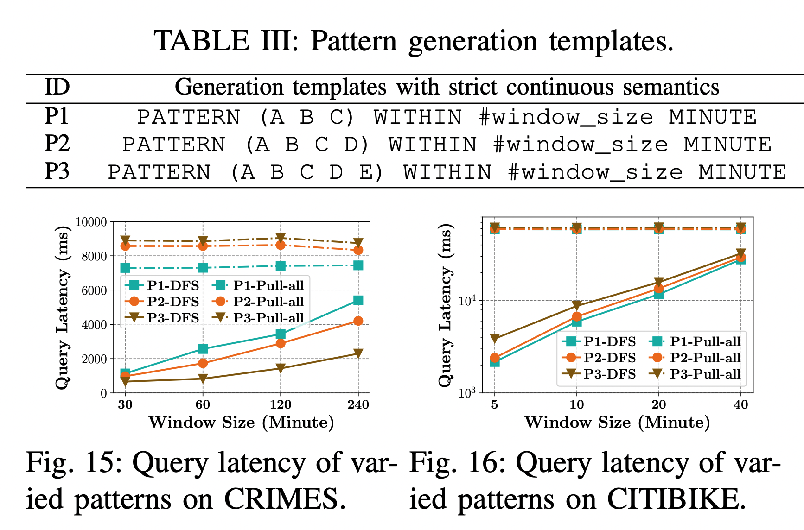
Results for Real-world Datasets
Under strict-contiguous semantics, DFS achieves a speedup of 1.5 × to 20 × over Pull-all.
Pattern generation templates
Query latency of varying patterns on CRIMES
Query latency of varying patterns on CITIBIKE
22
Notes:
Under strict-contiguous semantics, our approach (DFS) achieves a speedup of 1.5 × to 20 × over Pull-all.
Query latency of varied patterns on CRIMES.

Slide 23
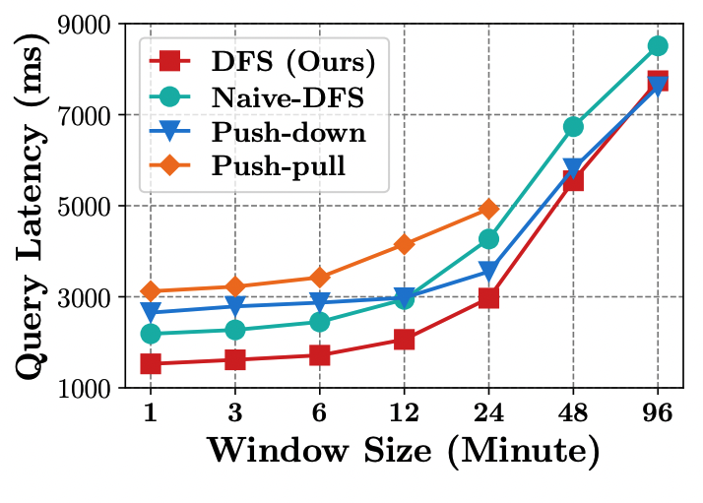
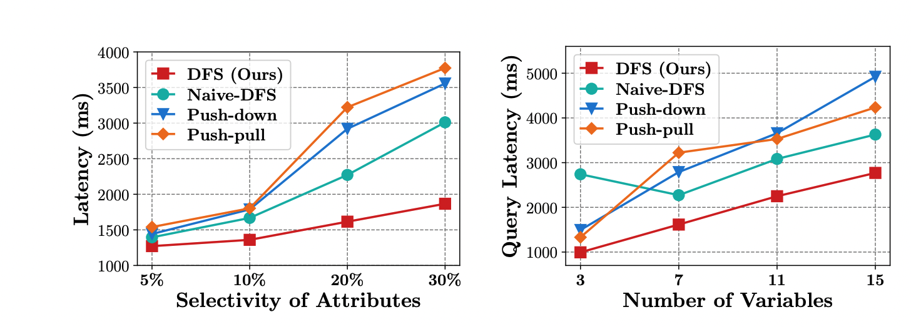
Results for Synthetic Dataset
The longer windows increase the number of events involved in matching, thereby reducing the effectiveness of pruning and increasing the matching time
As attribute selectivity increases, more events are transmitted, increasing query latency
As the number of variables increases, the cost of checking independent conditions rises, increasing scanning overhead for all approaches.
Query latency under varying window size, attribute selectivity, and number of variables
23
Notes:
On the synthetic dataset, we explore how specific parameters/features affect query performance.

Slide 24
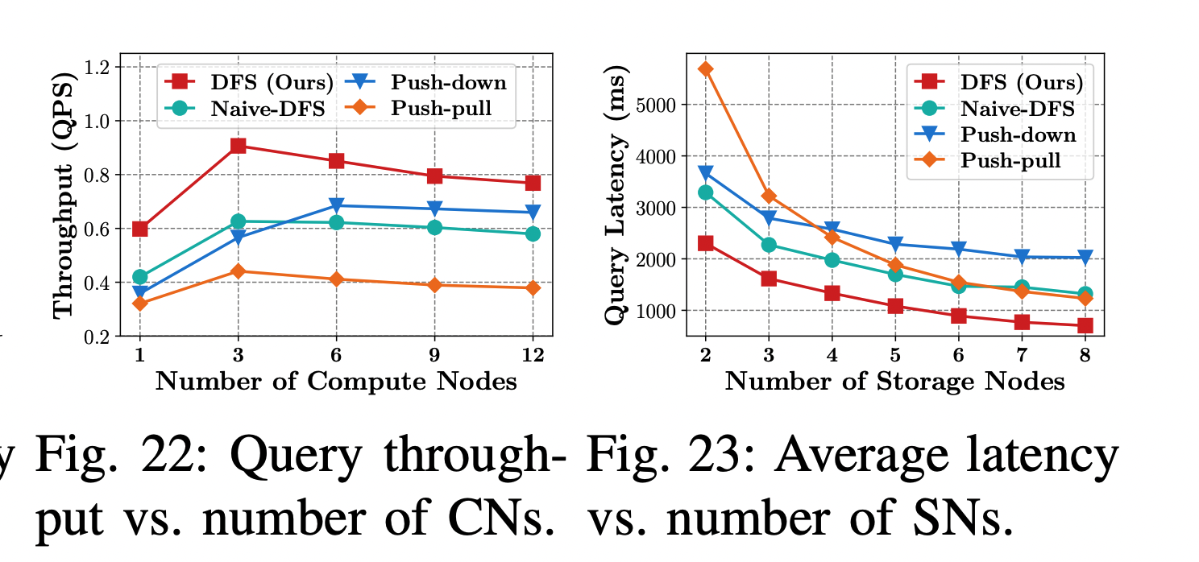
Results for Synthetic Dataset
DFS achieves the largest throughput gain when scaling the number of compute nodes
As the number of CNs increases further, rapid saturation of network bandwidth and memory resources diminishes the benefits of parallelism
DFS consistently achieves the lowest latency when scaling the number of storage nodes
Increasing the number of storage nodes improves parallelism in data loading ➜ lower query latency
Query throughput vs. number of CNs
Average latency vs. number of SNs
24
Notes:
When scaling from 1 to 3 CNs, DFS achieves the largest throughput gain, as it incurs relatively low filtering overhead and substantially reduces the volume of transmitted events, thereby lowering network bandwidth consumption. As the number of CNs increases further, rapid saturation of network bandwidth and memory resources diminishes the benefits of parallelism. When the number of CNs reaches six or more, the throughput of DFS, Push-pull, and Naive-DFS declines, as SNs maintain the intermediate state for each query, incurring high memory overhead that limits query concurrency. However, since DFS compacts SWF and releases SN memory as WJF is consumed, its throughput on 12 CNs remains higher than that of Push-down
Increasing the number of SNs improves parallelism in data loading, leading to lower query latency. DFS consistently achieves the lowest latency across all deployment scales
Average latency vs. number of SNs.

Slide 25
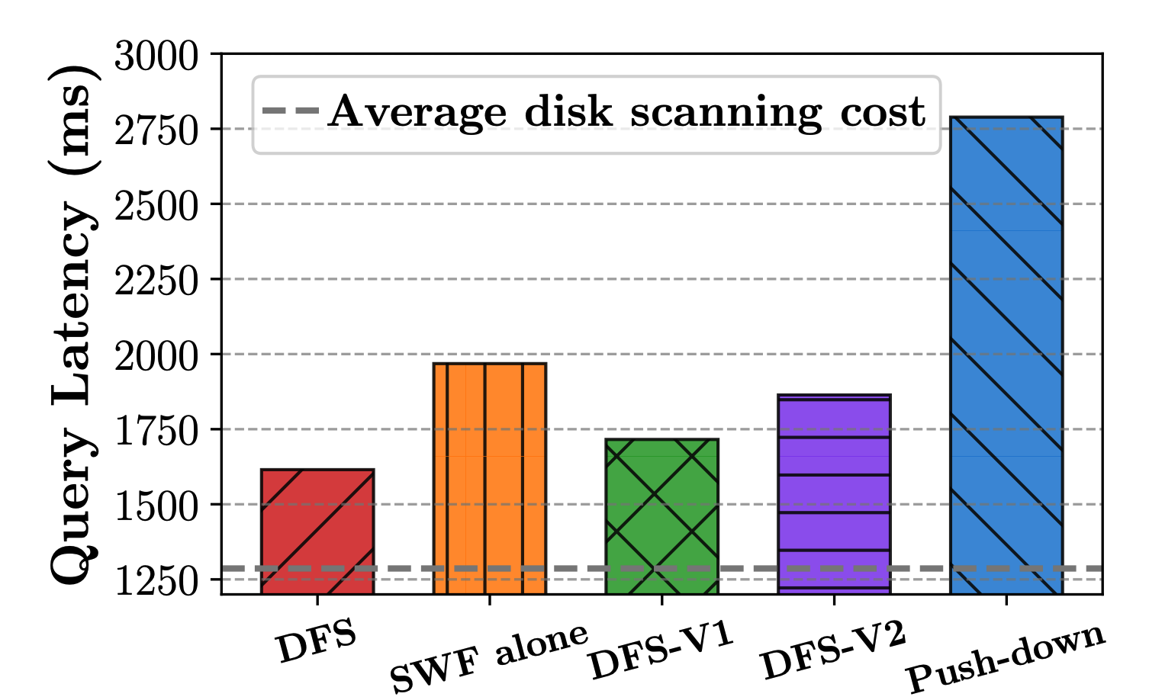
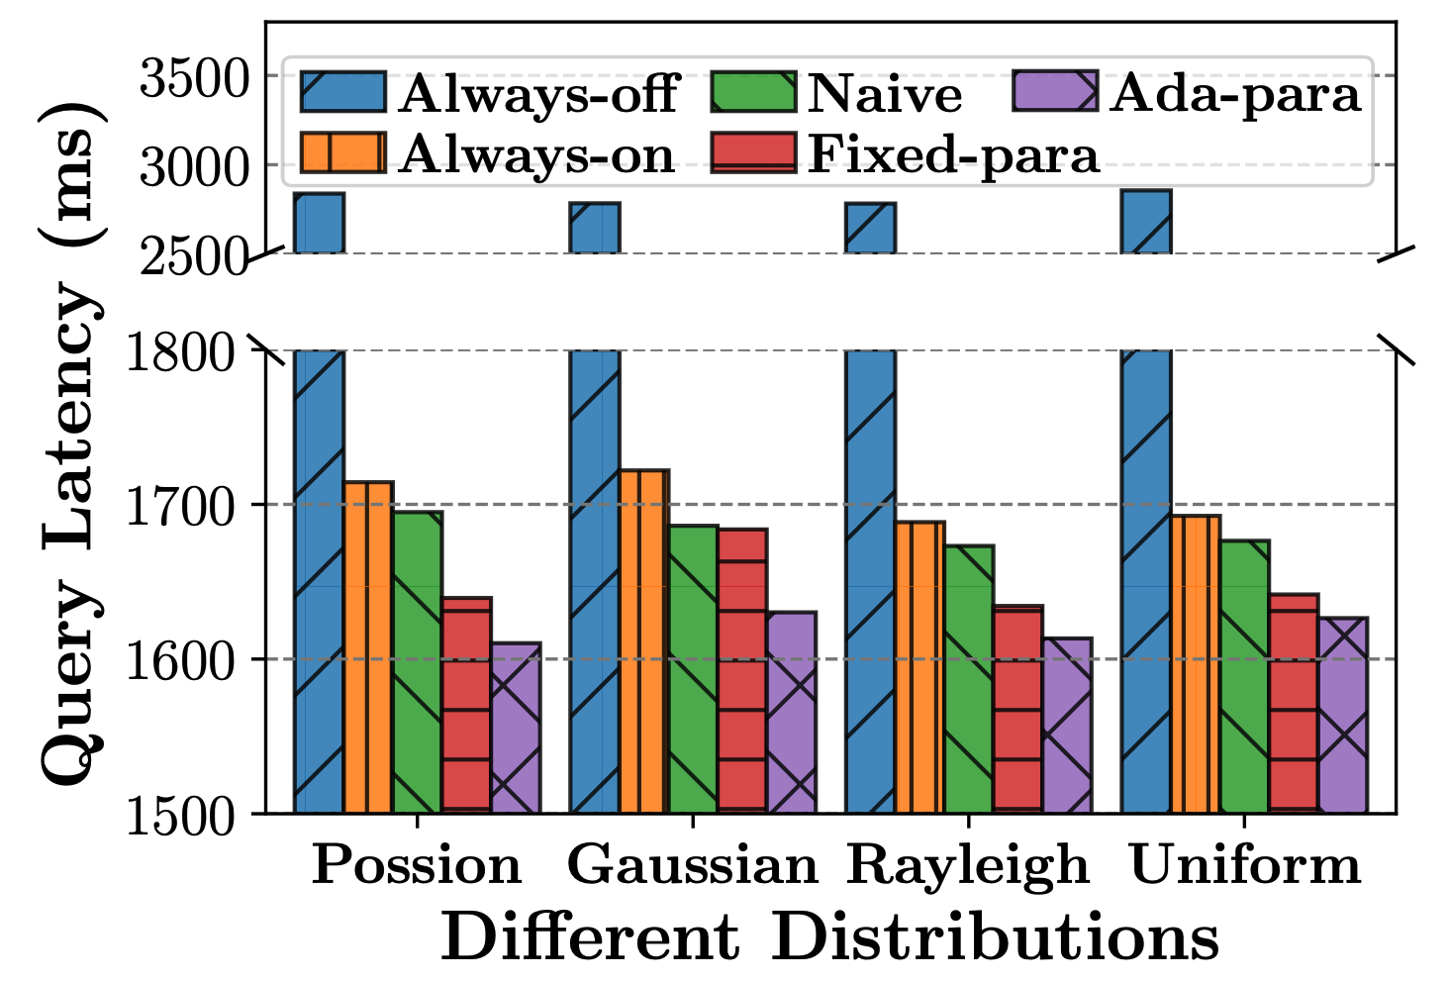
Ablation Studies on Synthetic Dataset
SWF and WJF contribute to latency reduction
SWF alone: disabling WJF in all round-trips
DFS-V1: replacing WJF with a hash table
DFS-V2: replacing SWF and WJF with naive interval array and hash table, respectively
Proposed cost model (ada-para) yields the lowest latency for DFS since it can eliminate detrimental round-trips
Ablation studies of system components
Average latency vs. varying cost models
25
Notes:
Ablation studies of system components confirm that SWF and WJF contribute to latency reduction

Slide 26
Conclusion
When complex event recognition operates in cloud-native architectures, network becomes a performance bottleneck
Our key insight is to identify shorter time intervals that contain matches and only transmit the events within those intervals
Our approach achieves a 1.2× to 25× query speedup compared with the SOTA
Complex
Event
Queries
Compute node 1
Compute node n
CER APP
…
CER APP
Try to reduce the transmission of query-irrelevant events at the lowest possible cost.
✄ Network
…
Distributed/Shared storage (EBS or S3)
26

Slide 27
Thank You! ❤️
Shizhe Liu
Nanjing University
✉️
shizheliu@smail.nju.edu.cn
Notes:
That’s all, thank you.

